Slide 1
RAG: Little dive into basics

Slide 2
What is RAG model?
The RAG (Retrieval-Augmented Generation) model is a concept that lets us utilize external knowledge as a contextual reference when interacting with AI assistants.

Slide 3
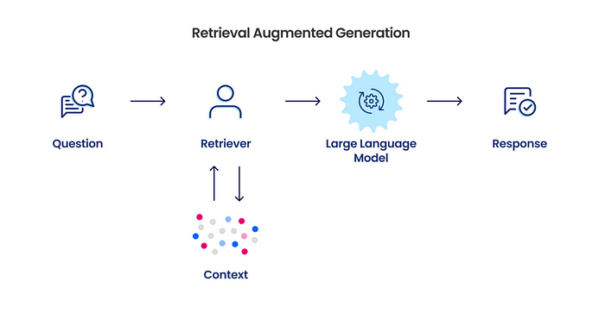
Overview of application with RAG architecture

Slide 4
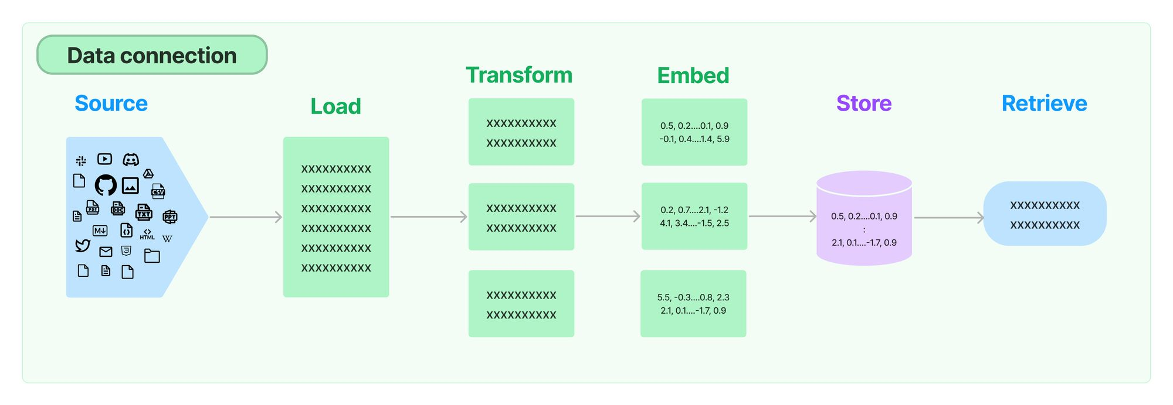
How we do create context?

Slide 5
Source:
.txt, .pdf, .xlsx, .xml, .html documents
Confluence
GitHub
Discord
WEB resource

Slide 6
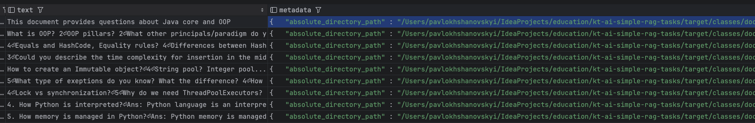
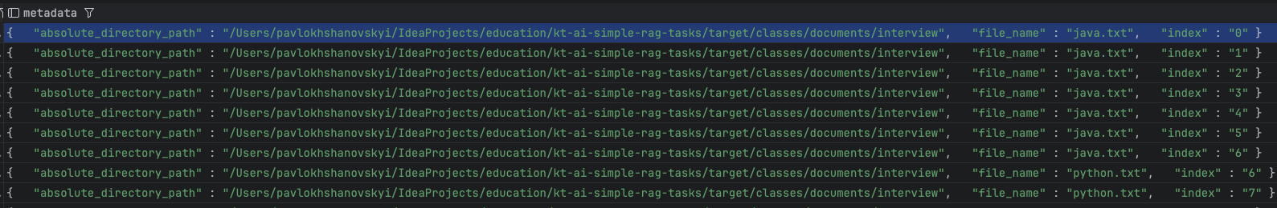
Load files or whatever as Documents
Spring and LangChain have a lot of tools to load files or data from WEB resources into Documents. Document is object where persist extracted data from resource and its metadata.

Slide 7
Transform (or slice)
Once we loaded Documents then we can slice them into more smaller Documents (chunks), add or modify data and metadata.
We can slice it semantically, by headers or amount of characters. This transformation speed up search from DB and reduces amount of tokens that implies on the query cost

Slide 8
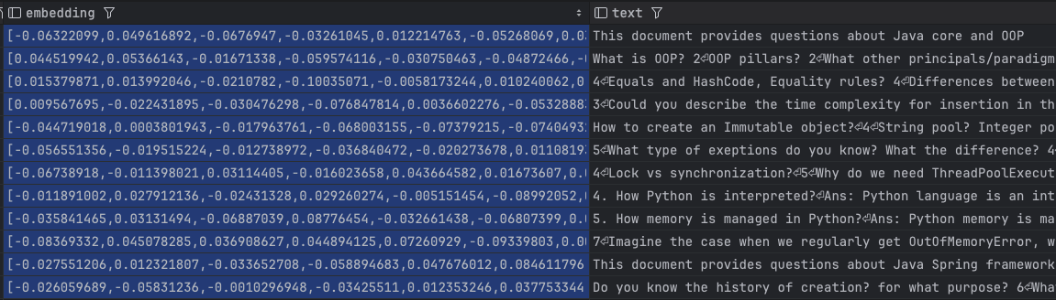
Create embeddings from Documents
Embeddings are vector representation of data.
Basically, it is decimal or numerical representation of tokes represented in a way that captures the relationships and similarities between different tokens

Slide 9
How we do create context?

Slide 10
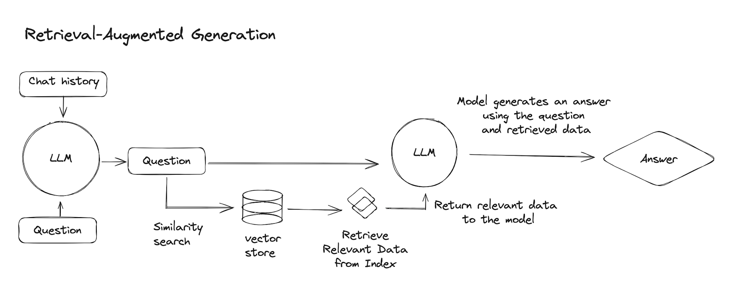
Final representation of flow:

Slide 11
Thank you

